Slide 1
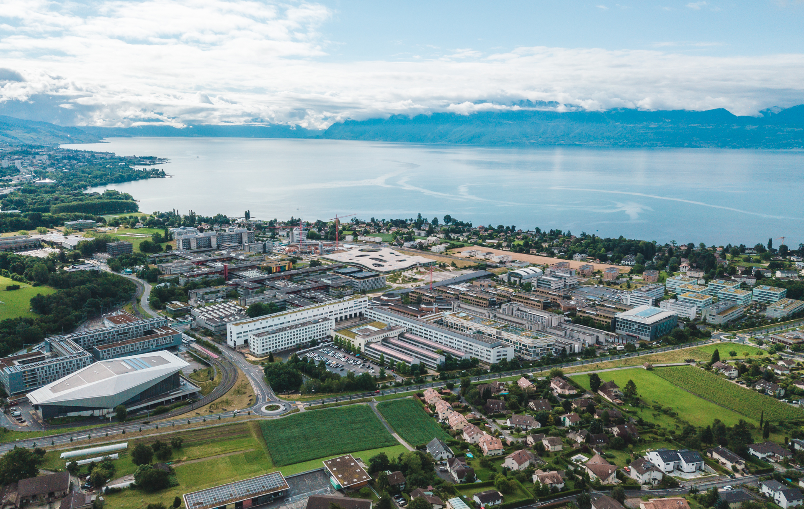
Machine Learning For EDucation
Jibril Frej

Slide 2
What is Machine Learning ?
Artificial Intelligence
Use examples to “learn” to solve complex problems.
Use examples of pictures with and without cats to “learn” if there is a cat in the picture
Use examples of books and their summary to “learn” to summarize books
How do we “learn”?
Machine
Learning

Slide 3
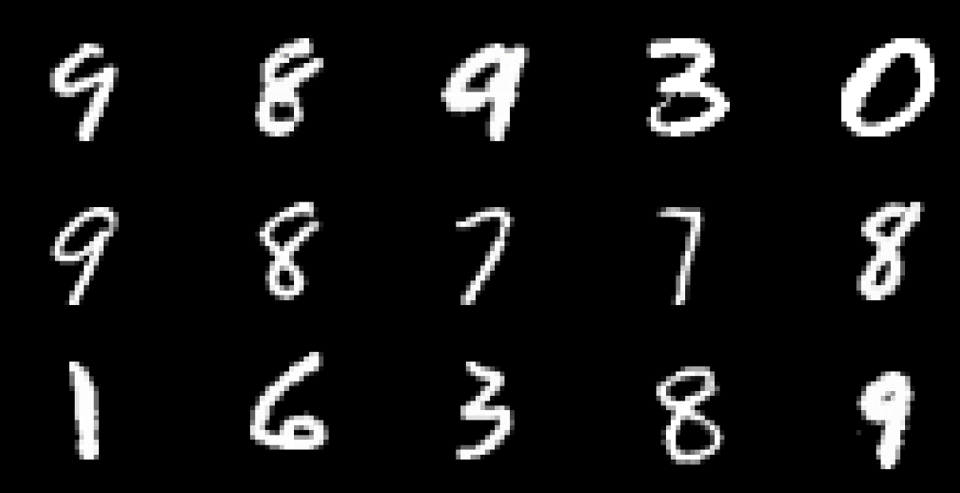

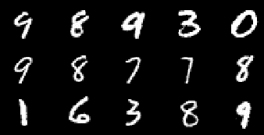

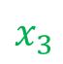

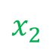
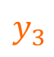

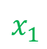
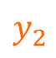
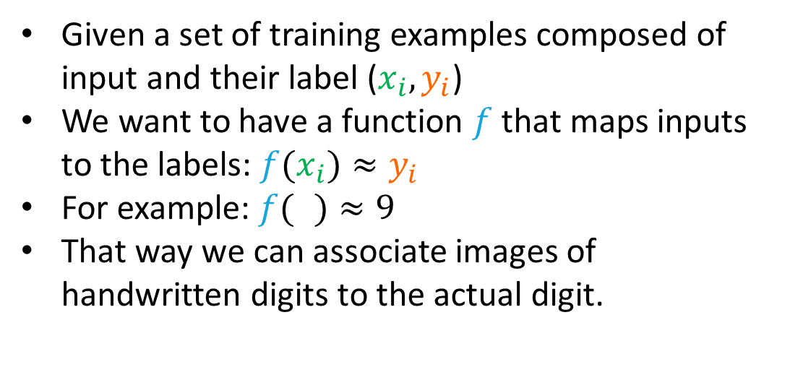
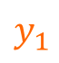
What is Machine Learning ?
Example on the MNIST dataset (handwritten digits)
Given a set of training examples composed of input and their label ($x_{i}, y_{i}$)
We want to have a function $f$ that maps inputs to the labels: ${f(x}_{i})≈y_{i}$
For example: ${f(}_{ })≈9$
That way we can associate images of handwritten digits to the actual digit.
$$f$$
9
$$y_{1}$$
$$x_{1}$$
$$f$$
8
$$y_{2}$$
$$x_{2}$$
$$f$$
0
$$y_{3}$$
$$x_{3}$$
https://www.kaggle.com/datasets/hojjatk/mnist-dataset

Slide 4
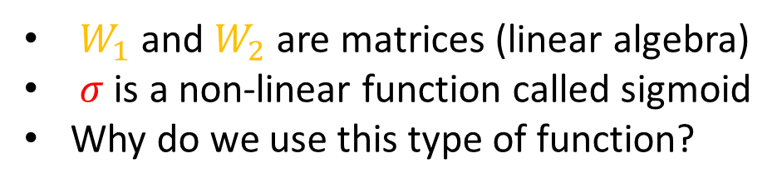
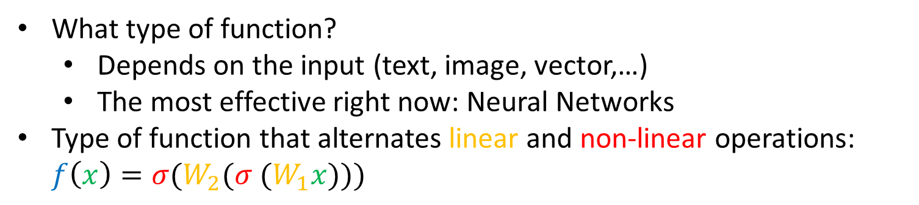
What is a Neural Network?
What type of function?
Depends on the input (text, image, vector,…)
The most effective right now: Neural Networks
Type of function that alternates linear and non-linear operations: $f\left(x\right)={σ(W_{2}(σ (W}_{1}x)))$
$W_{1}$ and $W_{2}$ are matrices (linear algebra)
$σ$ is a non-linear function called sigmoid
Why do we use this type of function?
https://playground.tensorflow.org

Slide 5
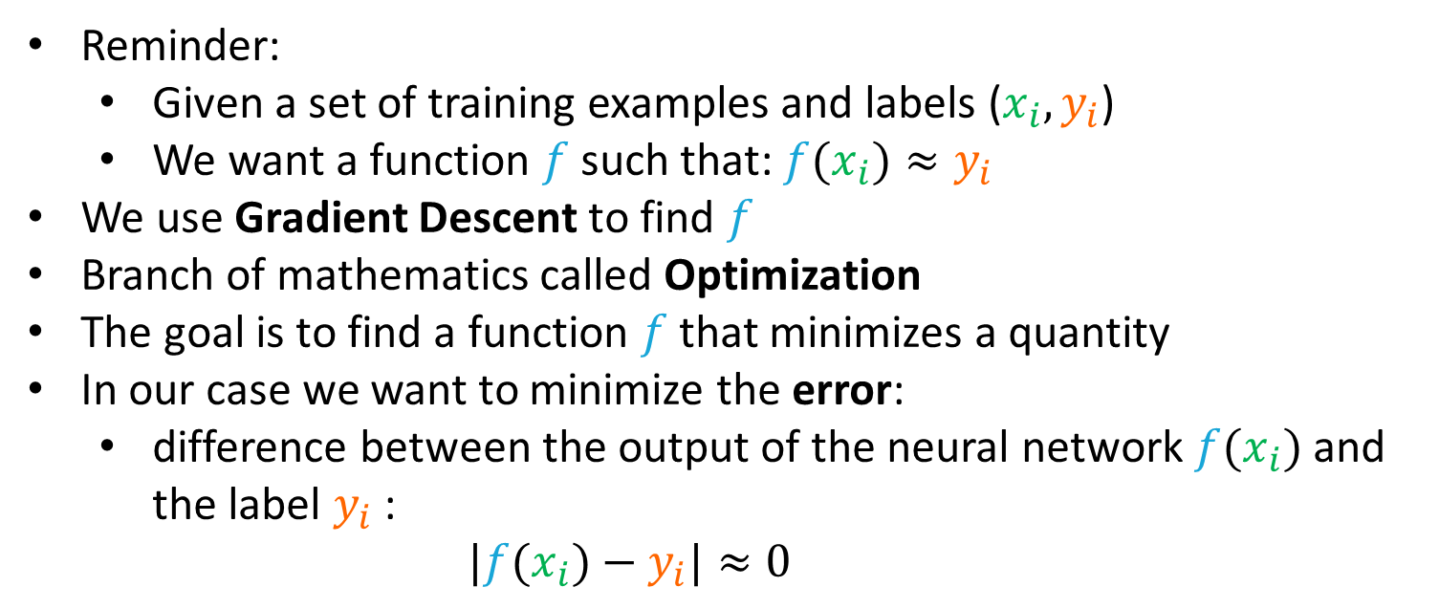
How do we train a Neural Network?
Reminder:
Given a set of training examples and labels ($x_{i}, y_{i}$)
We want a function $f$ such that: ${f(x}_{i})≈y_{i}$
We use Gradient Descent to find $f$
Branch of mathematics called Optimization
The goal is to find a function $f$ that minimizes a quantity
In our case we want to minimize the error:
difference between the output of the neural network ${f(x}_{i})$ and the label $y_{i}$:
$|{f(x}_{i})−y_{i}|≈0$
https://www.youtube.com/watch?v=aircAruvnKk&list=PLZHQObOWTQDNU6R1_67000Dx_ZCJB-3pi

Slide 6
Quick summary
To understand in the details how it works you need to know:
Linear Algebra (matrix multiplications)
Optimization (Gradient Descent)
Probabilities: a lot of the times Neural Network output a probability distribution
The python libraires for training neural networks (PyTorch, TensorFlow) are becoming very easy to use
BUT, if you do not know how Neural Networks works and how they are optimized, you will not be able to fix problems that will occur when you develop your own models

Slide 7
The specific case of NLP
In the case of NLP, we use Neural Network to train Language Models
A Language Model is a probabilistic model of language
For example, autoregressive Language Models used by ChatGPT:
Given a piece of text
Compute the probability of the next word
Specificities about modern NLP:
The type of Neural Network used is called Transformers
Neural network need vectors as input, not strings.
Each word, or token is associated with a vector that is called an embedding, before being processed by the Neural Network
https://huggingface.co/

Slide 8
Transformers
In the case of NLP, we use Neural Network to train Language Models
A Language Model is a probabilistic model of language
For example, autoregressive Language Models used by ChatGPT:
Given a piece of text
Compute the probability of the next word
Specificities about modern NLP:
The type of Neural Network used is called Transformers
Neural network need vectors as input, not strings.
Each word, or token is associated with a vector that is called an embedding, before being processed by the Neural Network
https://huggingface.co/

Slide 9
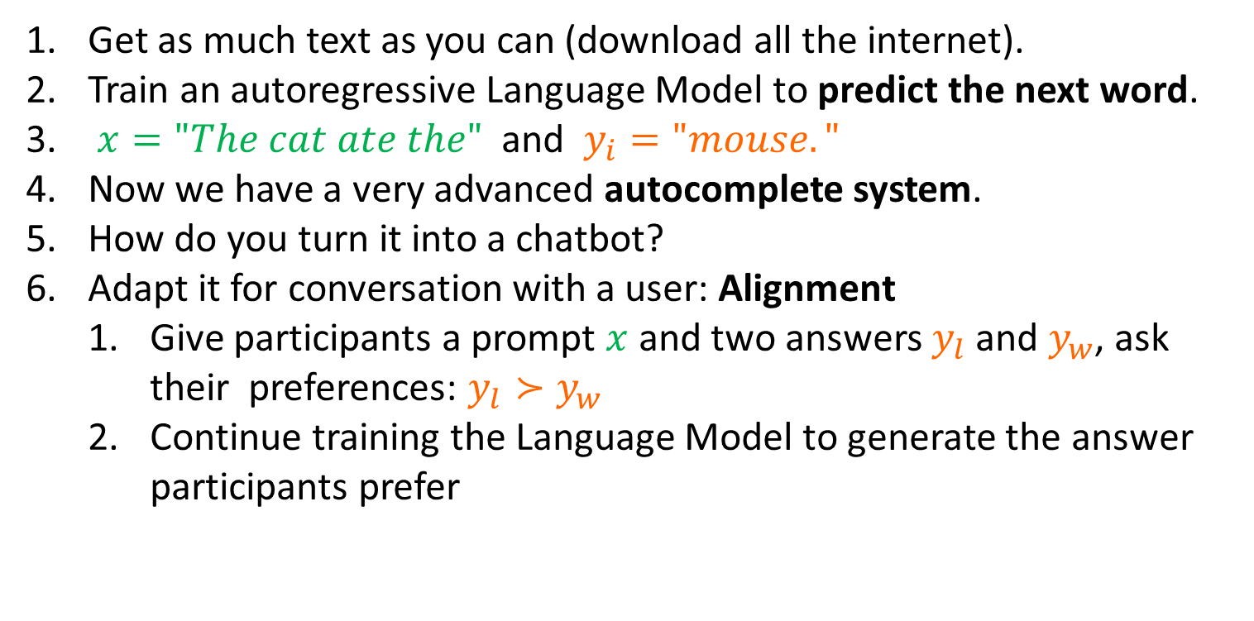
How does ChatGPT work?
Get as much text as you can (download all the internet).
Train an autoregressive Language Model to predict the next word.
$x="The cat ate the"$ and $y_{i}="mouse."$
Now we have a very advanced autocomplete system.
How do you turn it into a chatbot?
Adapt it for conversation with a user: Alignment
Give participants a prompt $x$ and two answers $y_{l}$ and $y_{w}$, ask their preferences: $y_{l}≻y_{w}$
Continue training the Language Model to generate the answer participants prefer

Slide 10
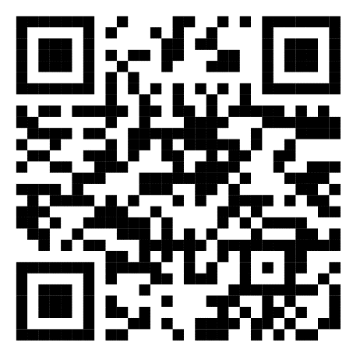
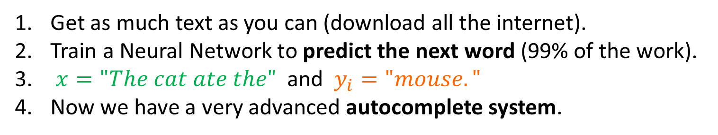
Tutorial
Get as much text as you can (download all the internet).
Train a Neural Network to predict the next word (99% of the work).
$x="The cat ate the"$ and $y_{i}="mouse."$
Now we have a very advanced autocomplete system.
I cannot do the next steps by myself
I would need participants that speak Khmer
https://github.com/Jibril-Frej/khmer_gpt

Slide 11
Tutorial
We saw how to develop a Language Model in Khmer
It is a good start, but it is far from perfect
To improve it you need to do the following:
Gather more data
Adapt the Tokenizer
Use a Language Model with more parameters
Train the Language Model longer
To turn it into a chatbot like ChatGPT you need to:
Gather preference data
Train the model on preference data
https://github.com/Jibril-Frej/khmer_gpt

Slide 12
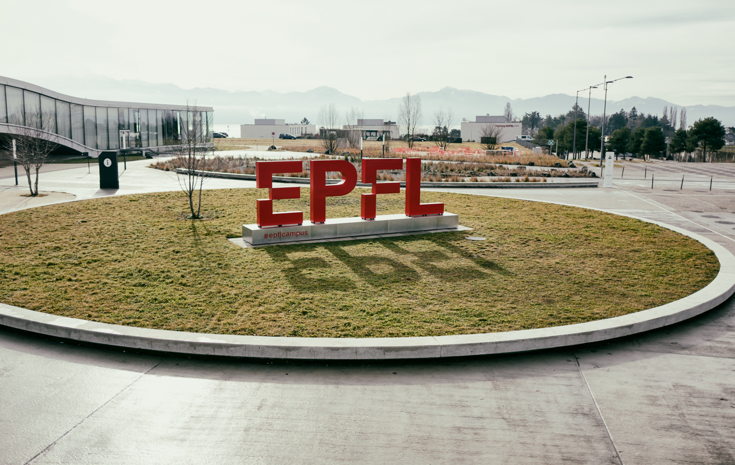
Thank you
Jibril Frej

Slide 13


